Slide 1

THE CHALLENGES OF LEADERSHIP
How do I grow myself?
How do I grow my team members?
What we do today does not equal what we do tomorrow
Can we know who will adapt and scale?

Slide 2

CONSTRUCTIVE DEVELOPMENTAL THEORY
How do we know what we know?
We have a lens
Our lenses change to become more complex as we grow
Life is a journey with many points of development - called leader levels
Note: This is NOT Collins. It is Jean Piaget,Robert Kegan, Lawrence Kohlberg

Slide 3

PERSONALITY TESTS
Myers Briggs
Hogan
DISC, etc.
These are useful to understand your style and the style of others. They are your vehicle on the journey.
BUT:
Your personality/style does not predict how you will, or have, grown and adapted to life’s challenges.

Slide 4
HOW IMPORTANT ARE SMARTS?
IQ is a factor
Technical skills are a factor
Personality and style are a factor
But as you move up—it is the combination of IQ, Personality, and Leader Level that matters

Slide 5
WHY IS THIS IMPORTANT?
The next 2 slides will address the complexity and challenges of:
A senior executive role (the CIO in our example)
Aligning a new leader within an organization

Slide 6
CIO REQUIREMENTS – VALUE CREATION
Leadership, People, Teams, Culture
Find Customers
Digital Engagement
Strategy
Innovation
Analytics/Big Data
Mobile
Social
Cloud
IoT
98%
Keep
Customers
Growth
75%
New & Growing Markets
Value
Service Delivery
Governance
Demand Mgmt
Security
Transparency
Vendor Engagement
Compliance
Volume
Efficiency
Leverage
Process Harmonization

Slide 7
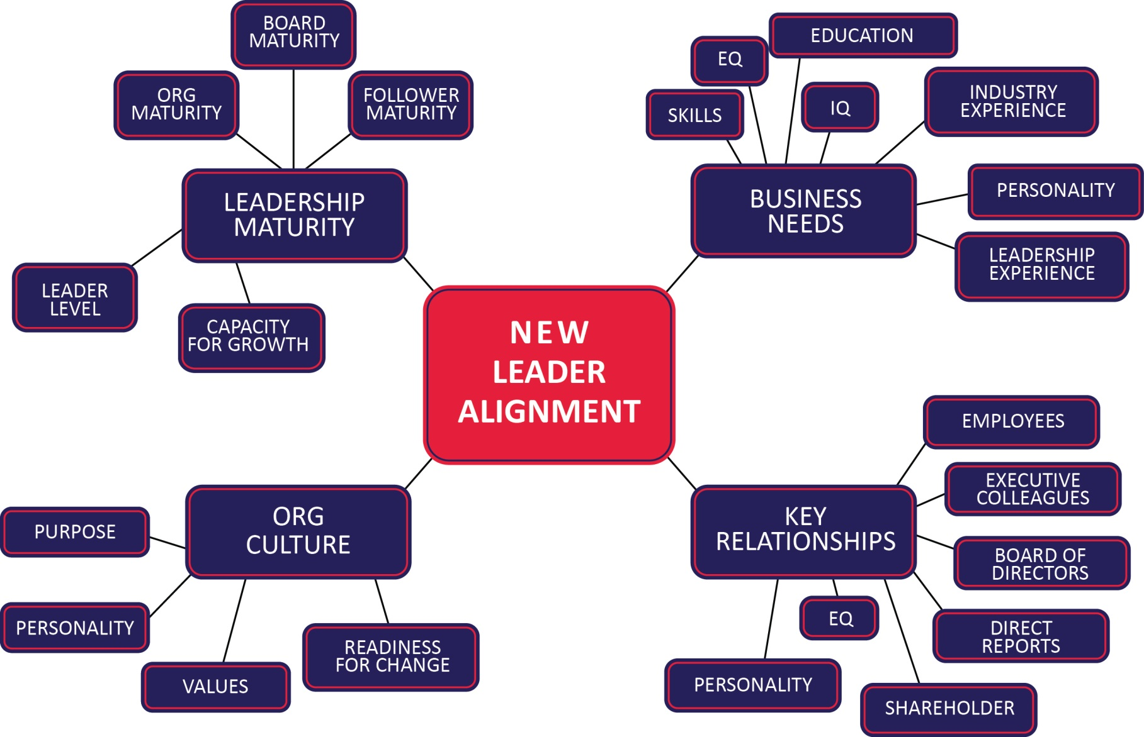
THE COMPLEXITY OF INTEGRATING A NEW LEADER
Document developed by Dr. Keith Eigel, Ph.D, The Leaders Lyceum

Slide 8

SOME BIG QUESTIONS
Can we know if an executive:
Will lead effectively?
Will scale as a company grows?
Will adapt as circumstances change?

Slide 9
ADULT DEVELOPMENT
Vertical and Horizontal
Perspective
Experiences
Personal Growth
Growth
Knowledge, Skills, Abilities, Traditional Training
Age
Based on: Abraham Maslow, Jean Piaget, Lawrence Kohlberg, Elliott Jacques, Robert Kegan and others.

Slide 10
REMEMBERING YOUR JOURNEY
How do you know what you know?
When did you learn the most?
What were the hardest lessons?
Reflecting
Understanding your impact
What enabled success at one stage may derail you later

Slide 11
THE FORMULA FOR GROWTH
“C” + “C”
T
X
P = EL
Challenge
Contradiction
Time
Perseverance
EL = Elevated Leadership
Copyright: Leaders Lyceum

Slide 12
LEADERSHIP DEVELOPMENT – LEVEL 2
It’s All About Me
My agenda
Rules and laws
Operates from own self interest (selfish). No Empathy.
Uses others to pursue own goals
Works to win no matter the cost. No compromise.
Oversimplifies into either/or; black/white
Motivated by reward and punishment
Crisp, concise, sure.
Only their perspective.
You scratch my back, I’ll scratch yours
Typically ages 10-17
5
Understanding from Inside-Out
4
What They Say
I’ll listen because you are the boss
He did that to make himself look good
Sometimes others have to look bad so you can look good
3
Understanding from Outside-In
<10% of leaders stay at this level.
2
Moving to LL3: Discovering that your agenda limits your success. You can’t always win. Start putting yourself in another's shoes.
Perceptions
1
Based on the work of Dr. Keith Eigel: Leaders Lyceum

Slide 13
LEADERSHIP DEVELOPMENT – LEVEL 3
Overwhelmed by Outside Influences
Defined by roles and relationships. High affiliation. Peer pressure. They are their role.
What they stand for is limited to what others will think
Circumstances determine well being. Social media.
Need to be known, liked, accepted, included.
Unlikely to take responsibility for mistakes (tends to blame – follows others – plausible deniability)
Reliant on outside sources to make sense of the situation or know what to do
Feels responsible for self-esteem of others. Harmony.
A portfolio of learned responses. Pygmalion.
Team unity paramount, results are secondary
Motivated by connections and acceptance
A loyal follower; reliable; likeable
Typically age 22, up to 34+
5
Understanding from Inside-Out
4
What They Say
I got xxx “likes”!
That’s not the way things are done here. Abilene Paradox.
The team approved it; it wasn’t my job to object
I am a manager – it is what managers do. Role defines identity and behavior.
*
3
Understanding from Outside-In
Effectiveness Transition
2
Perceptions
Moving to LL4: When what we take for granted breaks down
Based on the work of Dr. Keith Eigel: Leaders Lyceum
1

Slide 14
LEVEL 3 MANAGERS – SUPPLEMENTAL NOTES
They are their role. E.g. I am a Director of Infrastructure (L3) – I am a person who leads Infrastructure at….(L4)
They are a portfolio of outside viewpoints. They don’t “own” those inputs. They need those outside sources to make sense of the situation and to know what to do. (Novel circumstances can cause confusion). Don’t rock the boat! The Pygmalion effect – Lisa Doolittle just did what Henry Higgins said – he determined her reality.
Reflecting on who and what a L3 leader stands for is limited to what s/he believes others will think about who s/he is, and what s/he stands for. Classic example: If I did that… “what would my friends say” (L3) vs “I couldn’t look at myself in the mirror” (L4)
Relational harmony is paramount therefore a silly little argument can totally disrupt. (Remember in your 20’s when a little dispute with your significant other was all consuming)
Often believe they are doing the right thing by “lying” so as not to hurt another’s feelings. You can only speak helpful truths to those who need it when you are compassionate and secure.
They are endearing and likeable – know everyone, want subs to feel heard, they walk the talk, and total fit and identify with the company values.
All energy taken up in pleasing the boss, ensuring subs are happy, putting things back together.
Want to have others feel good about themselves.
Their identities are largely shaped by their position and formal power in the organization – which can make them arrogant and defensive.
Hard for them to take responsibility for their own decisions/mistakes – mostly blame others. Think through situations to make themselves bullet proof. Plausible deniability to protect a cherished role. Have the team vote, and go with that.
They do not like conflict – which often leads to better decisions. They consequently smooth over challenges to make them go away – rather than embracing them.
Based on the work of Dr. Keith Eigel: Leaders Lyceum

Slide 15


MID-LIFE CRISIS

Slide 16
MID-LIFE CRISIS
A mid-life crisis can come between L3 and L4
Instead of pushing through and finding meaning as you move into L4, a mid-life crisis often seeks a new external validation system.

Slide 17
LEADERSHIP DEVELOPMENT – LEVEL 4
Taking Ownership of your Life
Self defining/authored
It’s not where you are leading to – it’s where you are leading from
Sets vision, self-initiates, self-corrects
Has a system they adhere to (GPS)
Concerned about goals, standards, objectives
Shows compassion without owning others well being
Secure enough to listen, confident enough to make hard decisions
Uses feedback to REfine not Define
Grants others autonomy, can go to their level
Delegates, so staff grow
Average age is 44; can be 55, not often <35.
5
Understanding from Inside-Out
4
What They Say/Do
The buck stops with me
That’s something I am not willing to do. Do the right thing.
I listen to all input, then decide
Let’s agree to disagree
Okay with conflict, manage it.
*
3
Understanding from Outside-In
Effectiveness Transition
2
Perceptions
Moving to LL5: Realizing the inadequacy of our current understanding
1
Based on the work of Dr. Keith Eigel: Leaders Lyceum

Slide 18
LEVEL 4 MANAGERS – SUPPLEMENTAL NOTES
At L3 you are “done to”; at L4 you take responsibility for your reactions.
It is not where you are leading to – it is where you are leading from.
The content of what you know may not change, but your ownership of it does.
At L4 you lead with confidence (rather than L2 arrogance) but this can be seen sometimes as cockiness.
L4 leaders are defined by their values which are integrated into their identity, demeanor and communication. They are seldom <35 years old.
L4 leaders give others autonomy which can be misinterpreted as detached, uncaring and aloof.
If you report to a L4 you might not get a lot of positive feedback, you probably get mostly criticism, which can negatively affect L3 people. L4 leaders need to realize this and get down to L3 and give the encouraging feedback.
L4 typically comes up as “gravitas” – leaders who know who they are, and what they stand for, and can communicate that.
L4 leaders can set aside relationships and how others feel about them for the good of the company.
L4 leaders delegate to enable team members to develop skills, gain experiences, and perform more effectively.
Based on the work of Dr. Keith Eigel: Leaders Lyceum

Slide 19
LEADERSHIP DEVELOPMENT – LEVEL 5
The Ability to Rise Above Yourself (<15% of population)
Open – take an objective view of themselves, compare their paradigms to those of others
Grounded in, and leads through higher order values
Self-aware , self-reflecting, authentic, rigorously honest
Can be hard to get to L5. You get comfortable and can insulate yourself.
Others valued as co-contributors and co-learners. Differences are appreciated.
Intentionally focused on developing and growing others (not their own welfare)
Capacity to see oneself objectively. Humbly.
Typically mid to late 50’s
5
Understanding from Inside-Out
4
Characteristics
They seem wise
Open – don’t have a set system. Our way may not be the best way.
Define success as achieving a valued outcome
Value and learn from conflict
Do the right thing for the right reason
It’s not us (company), it’s all of us (world)
Asks: What am I missing? What’s new?
How can I be more inclusive?
3
Understanding from Outside-In
2
Perceptions
1
Based on the work of Dr. Keith Eigel: Leaders Lyceum

Slide 20
LEVEL 5 MANAGERS – SUPPLEMENTAL NOTES
Higher order values:
  Openness
  Honesty
  Courage/Bravery
  Justice
  Selflessness
  Productivity
  Service
  Respect for and values others
  Authenticity
  Vulnerability
  Mercy
  Goodwill
  Kindness
  Generosity
L5 leaders are all about growing others;
  Meet others where they are (their Level)
  Maintain humility about their own contributions.
  Open to understanding the perspectives of others.
  They intentionally evaluate their own experience/reactions to see where they need to loosen their grip.
Feedback. At L4 a leader uses feedback to refine him/herself. At L5 a leader uses feedback to model receiving feedback to the lower Levels. They are demonstrating honesty, openness, respect, and gratefulness to the feedback of others.
Conflict. L5 leaders see conflict as a value more than a problem. L4 leaders see value in conflict, but they invest energy in managing the conflict.
Problems. L4 leaders will tend to hands on help solve the problem or tell staff what to do. L5 leaders focus on the developmental opportunity behind the problem. They may step back, and potentially let someone fail – so that they can learn.
Based on the work of Dr. Keith Eigel: Leaders Lyceum

Slide 21
LEVEL 5 MANAGERS – SUPPLEMENTAL NOTES CON’T
What of Collins Level 5 Leadership? There is overlap. Collins L5 = a way of doing/acting. This Level 5 is a way of knowing/understanding. In top leaders these two look very similar. Collins L5 leaders display humility, concern for and development of others and their institution above themselves.
It is hard to move to L5 if:
  Achievement of objectives is more important than selflessness
  Self-protection is more important than vulnerability
  Maintaining their system is more important than being authentic
  To get to L5 ask – “what is the most generous, helpful and service minded thing I can do?”
  Embrace challenges in key areas. This means really listening to the other person and then working to reconcile the tension (C+C):
    Faith
    Politics
    Biases – cultural/racial/ethnic/gender.
Success can impede growth to L5 because you have the resources that stop growth. Challenges can get purchased away or avoided. Why change if I am successful?
Under what circumstances can you get to L5?
  Hard situations such as loss of: spouse, kid, friend, job, health, money.
  Set out to intentionally serve others so we seek to understand the way they see and do things. We will start to see ours is NOT the only way.
  Ask – what is the one thing I can do differently to make you more effective?
The world never stays the same. L5 leaders stay relevant because they are open to new ways, but stay routed in the higher order values.
L5 leaders seem to be wise.
They have an increasingly accurate self-assessment because they are self-reflective and rigorously honest. They realize that others potentially have just as good (or better) visions, values, and ways of doing things; the by-product of which is humility.
Based on the work of Dr. Keith Eigel: Leaders Lyceum

Slide 22
LEVEL 5 MANAGERS – SUPPLEMENTAL NOTES CON’T
They make sense of complex circumstances and create a culture that nurtures the growth of the people who work for them.
They tend to shun the spotlight.
At L5 you may need to build a new road. At L4 you have a GPS that you know and trust (a system) that you need to let go of to build that new road.
Building a new road is risky, you need others, and it could fail. (Lots of C+C)
Based on the work of Dr. Keith Eigel: Leaders Lyceum

Slide 23

LEARNING FROM LIFE
The experiences in our life that are most developmental are the hardest.
They usually involve loss of:
  Relationships
  Finances
  Health
They have the most collateral damage
They are hard to sweep under the rug
They can’t be imitated in a training environment
BUT: They are not the only path to growth.

Slide 24
CAN WE GROW OURSELVES AND OTHERS?
Yes. Use the growth formula C+C x P = EL
Honestly access where you are, then move up.
What holds you back? The 5 D’s:
  Distraction – Urgent crowds out important
  Dishonesty – We don’t accept reality. We self-deceive and see the problems as “out there” not “in there”.
  Deception – The world points us in the wrong direction. Beer = happiness; quick external fixes.
  Discouragement – We tried and failed. No perseverance.
  Disinterest – We settle for less. It is just too much effort.
T

Slide 25

GROWING YOURSELF
Grab every stretch assignment. Reflect on how
you cope.
Embrace challenge and contradiction
Lean into the growth formula C+C x P = EL
Persevere through challenges – learn about yourself
Do you hunker down, keep old methods, or change?
Solicit feedback and ask “what can I do to make you more effective?”
Get a mentor
Marshall Goldsmith: What got you here won’t get you there
T

